Slide 1
1.PIGSARData
2.PIGSAR(I)
Chengshu
Mora Lab
Group Meeting, 30/04/2019
Notes:
1

Slide 2
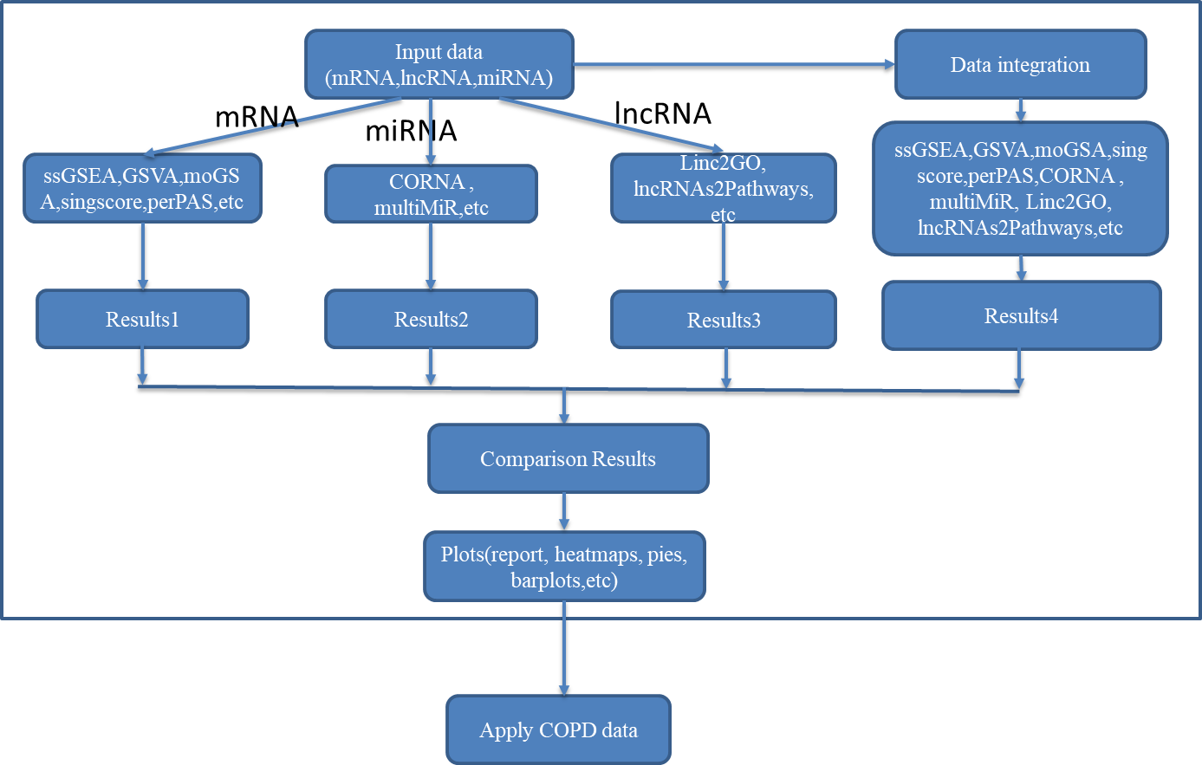
Goals of this project
A pipeline for single-sample analysis and integrative mRNA-ncRNA data.
1
Notes:
2

Slide 3
CONTENTS
I. Changes in Datasets
II. Progresses in project
2
Notes:
3

Slide 4
CONTENTS
I. Changes in Datasets
3
Notes:
4

Slide 5
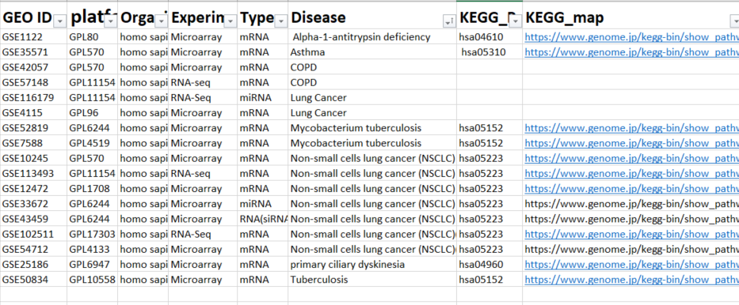
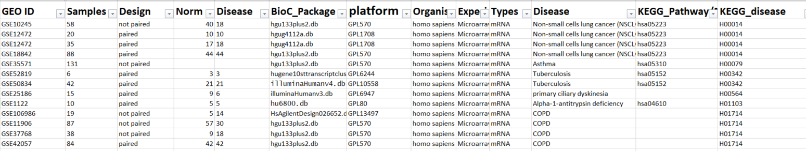
Datasets changing
7 diseases: COPD, lung cancer(LUAD), Asthma,
Non-small cells lung cancer (NSCLC),
Alpha-1-antitrypsin deficiency,
Mycobacterium tuberculosis,
primary ciliary dyskinesia
6 diseases: COPD, Non-small cells lung cancer (NSCLC),
Alpha-1-antitrypsin deficiency, Asthma,
Mycobacterium tuberculosis,
primary ciliary dyskinesia
6
Notes:
5

Slide 6
Why to change?
1. Removed all RNA-Seq data in current presentation, and there are a new form of RNA-SEQ data
2. Lung cancer doesn’t have a specific KEGG Disease ID….Difficult to match…
The datasets presented here are just as pre-demonstration, with time going by, if there are other better datasets, we could add.
GSE85214 | GPL16791 | homo sapiens | RNA-seq | miRNA | Asthma | hsa05310 | H00079
GSE94907 | GPL16791 | homo sapiens | RNA-Seq | mRNA | Tuberculosis | hsa05152 | H00342
GSE106899 | GPL11154 | homo sapiens | RNA-Seq | mRNA | COPD |  | H01714
GSE102511 | GPL17303 | homo sapiens | RNA-Seq | mRNA | Non-small cells lung cancer (NSCLC) | hsa05223 | H00014
GSE55320 | GPL16558 | homo sapiens | RNA-seq | mRNA | Asthma | hsa05310 | H00079
7

Slide 7
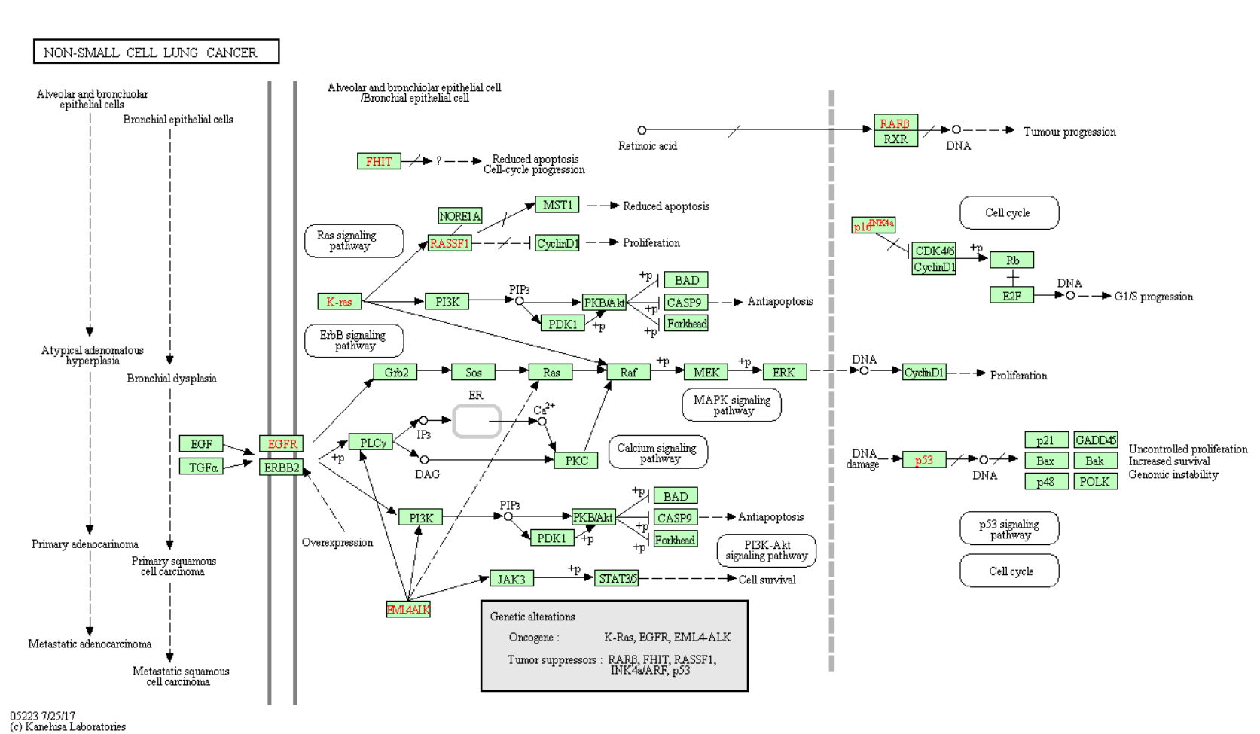
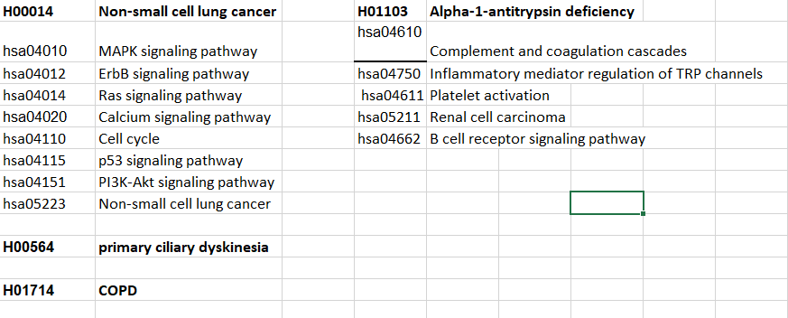
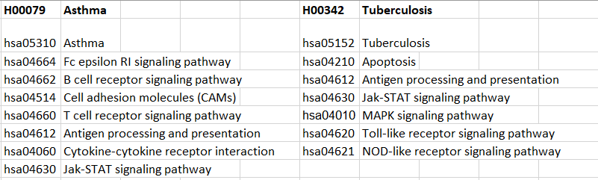
Target Pathways of different diseases
8
Notes:
7

Slide 8
Expression Data Format:
ExpressionSet class and matrix
Pathway Data Format:
Genesetcollection、list
Object:
GSE50834eSet-----ExpressionSet class
GSE50834_setentrez----matrix
KEGG_genesetcollection-----GeneSetCollection
KEGG_genesetlist-----list
9

Slide 9
CONTENTS
II. Progresses in project
10
Notes:
9

Slide 10
Applied to methods:
GSVA(methods = ssgsea, plage, gsva, zscore)……
1. Input format
gsva() needs two input file: expression data file(matrix class)、
pathway file(genesetcollection class)
2. Output format
list of 4 result due to different methods
“try_H00342” : the result of “tuberculosis” disease(keggID is H00342)
3. Objects in R
2 datasets : GSE52819_setentrez(42 samples), GSE50834_setentrez(6 samples)
pathway file: KEGG_genesetcollection
KEGG_genesetlist
11

Slide 11
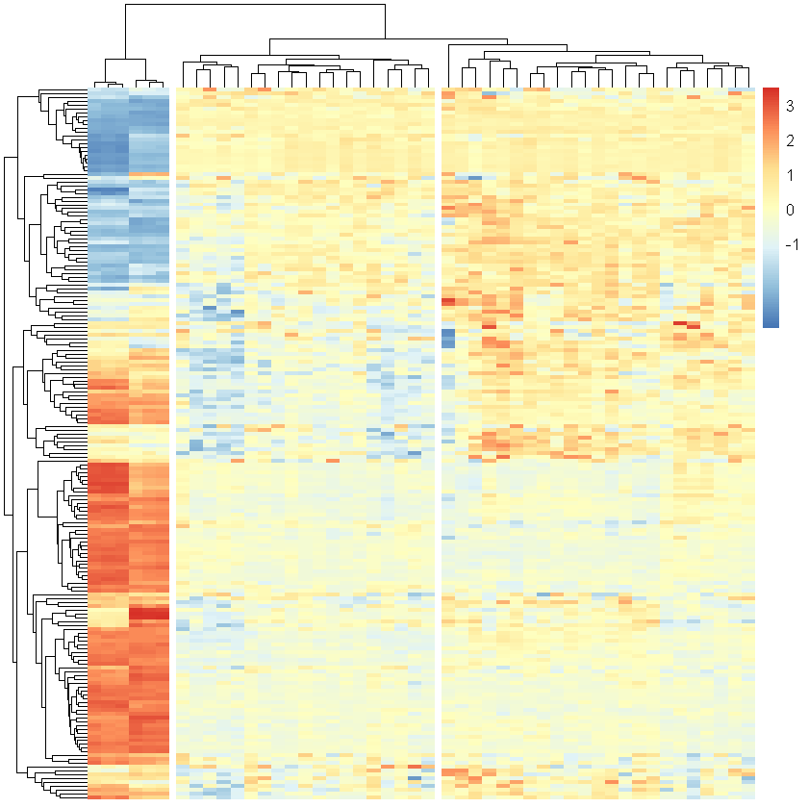
Applied to methods:
GSVA(methods = ssgsea, plage, gsva, zscore)……
Example:
2.1 Clustering in heatmap (ssgsea result)
3 Clustering:
6, 19, 23
The values mean the scores of each sample in different pathways
So, the higher the score, the higher the rank
12

Slide 12
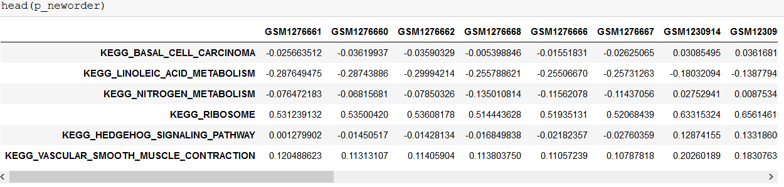
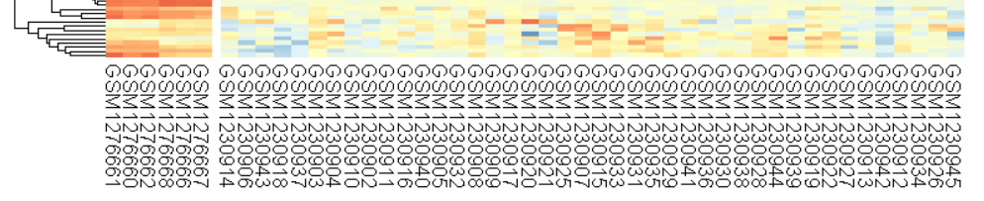
Applied to methods:
GSVA(methods = ssgsea, plage, gsva, zscore)……
Example:
2.1 Clustering in heatmap (ssgsea result)
From left to right
12

Slide 13
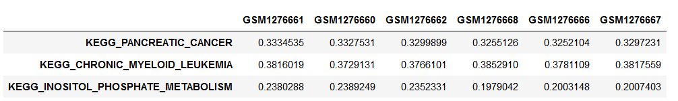
Applied to methods:
GSVA(methods = ssgsea, plage, gsva, zscore)……
Example:
2.1 Clustering in heatmap (ssgsea result)
Choose the largest value of each sample in all pathway
12

Slide 14
One function can be written to get all result of different methods(ssgsea , plage, gsva, zscore,)……
Question: choose the better way to rank
13

Slide 15
Next plan:
1. mRNA
1.1. Get ranks from clusterings
1.2. Calculate precision, specificity and sensitivity
1.3. Comparison of different methods(4 methods temporarily)
2.miRNA
2.1 Read paper : “CORNA(2009)”
14

Slide 16


Thank you!

